Slide 1

Multi Asset Class
Market Analysis
Project Manager – Tony Huang
Senior Developer– Viseth Auk
Data Visualisation Specialist – Ashley Neville
Data Consultant – Anh Thi Dang

Slide 2







TEAM MEMBERS
Tony Huang
Viseth Auk
Ashley Neville
Anh Thi Dang
Project Manager
Senior Developer
Data Visualisation Specialist
Data Consultant
Key contact for driving the project forward and ensuring the project is completed on time.
Responsible for maintaining the git repository ensuring that all pushes and pull are in good order and in sync with all members.
Work closely with the project manager to ensure that all requirements are met and delegate the necessary tasks to fellow member for completion.
Review all codes written to ensure that all standards are followed.
Provide advice and mentoring to team members when faced with challenges.
A key player in the visualisation component of the project. He will assist the team with collating various results from our research and presenting them in a meaningful way in the dashboard.
Work with the Senior Developer to create and maintain the required documentation for the project.
Plays an important role in ensuring that the data is correctly loaded and clean before analysis can begin.
Provide advice on any data issues we may encounter and offer options to resolve them.
Primary goal is to ensure that all data sets can be obtained and are adequate for testing, clean, unbiased and free from error.

Slide 3
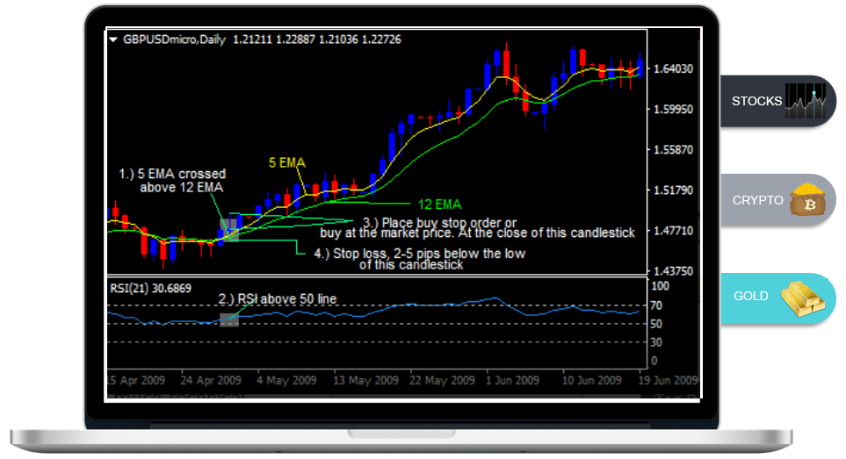
Project Motivation
Our team has a combined capital of $60,000 and wishes to venture together and invest in a trading strategy across 3 asset classes: stocks, crypto and gold.
Crossover Moving Average
We have found in many finance literatures that the crossover moving average is a popular strategy people use and wish to explore this trading strategy as a possible technique to use to invest our funds.
This project seeks to answer the following questions:
How should we best allocate the capital across these asset classes to minimise risk?
Which asset will this strategy work best for?
Was there any relationship between these assets?
On what basis do we decide that this strategy is better for a particular asset compared to the others?
Could a buy and hold strategy have performed better?
Which asset were inherently more risky?

Slide 4

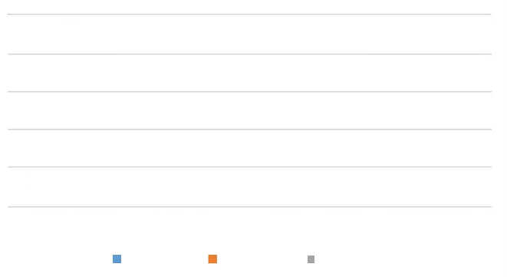



Summary & Result Findings
Cumulative Profit: * Initial Investment of $20k Allocated to each Asset
$150k
BUY & HOLD WINS
Based on our research, results suggest that a buy and hold approach is more superior, and we should allocate most of our investments to buy and hold rather than applying the popular moving average strategy
$100k
$24k
BOOMING MARKET
The Bitcoin data used for analysis and comparison included a period where the market was in a booming trend for a new and highly innovative financial asset. This trend may not continue in the future.
$12.5k
$6.6k
$3.7k
DATA NOT UNIFORM
Moving Average
Buy & Hold
The performance on bitcoin buy & hold strategy could have shown as even more favourable had we been able to obtain data a bit earlier. The earliest data we could get was in Sept 2017.
Stocks
Gold
Bitcoin
INADEQUATE INTERVAL
The result on the market analysis on the moving average strategy is a bit bias as the strategy was constructed on a very long time frame ( daily data )

Slide 5


QUESTIONS & DATA
What data do we need to reach a decision on where to invest our funds?
What type of data do we need?
Where can we get our data?
Initially we understood that the only data we needed for this analysis was:
O : Open Price
H : High Price
L : Low Price
C : Close Price
V : Volume traded
There were a few places we had in mind.
We ended up obtaining data from:
Binance ( using the python-binance library )
Using Python’s yfinance library
Extra data from Yahoo Finance website
How can the BackTrader library work with this data?
How much data would be sufficient for this analysis?
In order to use the BackTrader library we had to ensure that the data had an extra field for ‘open interest’. This field is not used in the strategy but is required.
We believe that daily prices from the last 5 years for each of these assets should be sufficient for this analysis.
We also had to ensure that the date was in the format of YYYY-mm-dd HH:MM:SS

Slide 6



Data Exploration Challenges
We intended to analyse the data using 1H time intervals but had difficulties obtaining them for both Gold and S&P 500 so we ended up changing the data to daily data instead.
The data exploration process took longer than anticipated.
Difficulty understanding why the API for BTC returned no data for a particular date/year range. It turns out that either Binance did not exist then or that the particular symbol did not exist at the time.
We had to introduce an extra column (Open Interest) so that the data would work with our third part library BackTrader.
Data needed to be in a particular format for BackTrader to function, it took us some time to understand this and debug the issue.
Cleansed Data
Source Data
Validate Data and Export to CSV
Check Data File
Insert Extra Interest Column
Set Date Format to Date Time
Data Cleanup
Sort Date in Ascending order
Process
Drop or Replace Nulls
Drop unwanted columns
Check for Nulls and NA’s

Slide 7
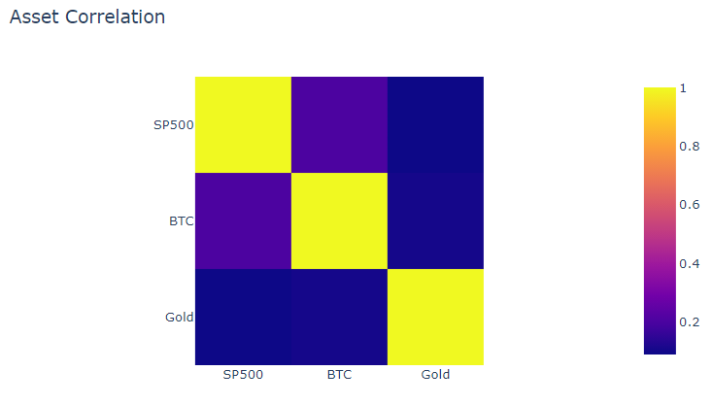
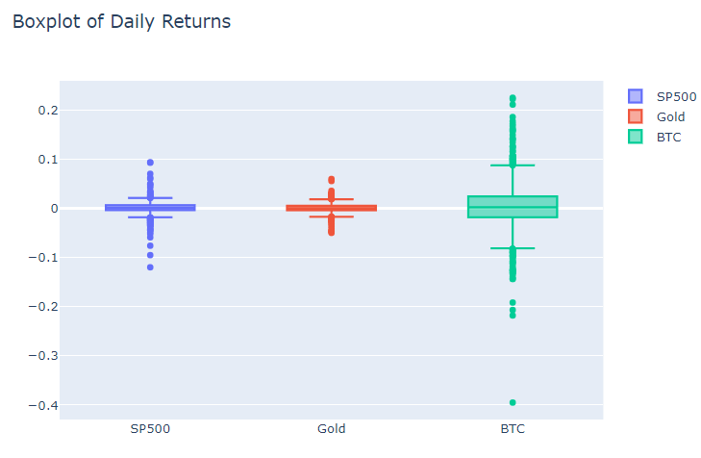
Data Analysis
Was there any relationship between these assets?
Plotting the correlation of the three assets, little to no correlation is found.
How should we best allocate the capital across these asset classes to minimize risk?
Since there is little to no correlation, we decided to equally divide the funds into the three assets to hedge against large price movements of one asset.
Which asset were inherently more risky?
The boxplot of daily returns shows that the mean and standard deviation of bitcoin is the largest, and hence the most risky.

Slide 8
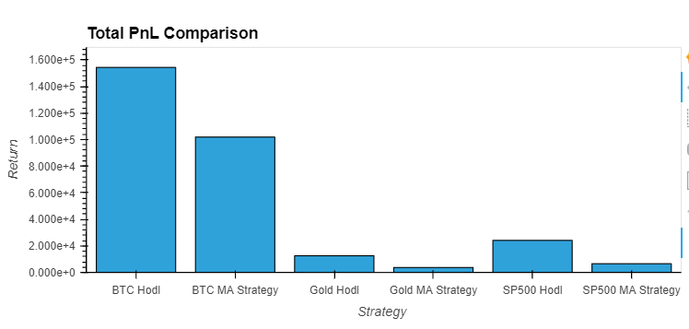
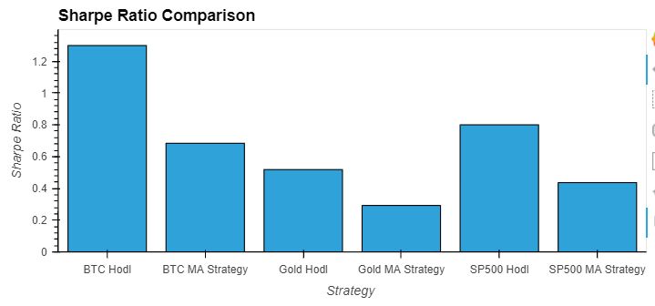
Data Analysis
Which asset will this strategy work best for?
The moving average strategy yields profits across all three assets, but little optimization was done to get better performance.
Could a buy and hold strategy have performed better?
The buy and hold strategy outperforms the moving average strategy in all three assets.
On what basis do we decide that this strategy is better for a
particular asset compared to the others?
Using sharpe’s ratio, to normalize the profit against risk, the strategy can be compared across each asset.

Slide 9

Discussion
Discussion
Our findings show this moving average strategy performs worse than buy and hold strategy.
Based on historical data analysis, particularly sharpe ratio, more capital should be allocated into a buy and hold btc strategy.
We expected the strategy to perform better, but since our data was limited to about 1400 days, the strategy enter 13-17 trades over the 5 years period.
Our results infer that a buy and hold strategy results in better returns than using this strategy on a daily timeframe.
If we got hourly data, there would be significantly more trades, allowing profits to be compounded, which may have led to higher pnl.
But our findings are inconclusive, as we had insufficient data to perform enough trades for a compounding effect.

Slide 10


Postmortem & Research Limitations
Performance Based on a Booming Trend
Past Results
The concluded result was based on a new emerging technological trend that was booming. Investing based on the result of this research does not mean this trend will continue and have the same outcome
Findings were based on past historical prices and do not reflect market behaviour of current times
Data Collection
Accuracy
This research relies heavily on the third party library called BackTrader and we are questioning the accuracy of this library.
The price series collected were based on the daily chart and the comparison of the time periods were slightly skewed ie: the time period for each assets did not completely match each other.
What Now?
With a bit more time we would make extra effort to obtain hourly data and compare the differences in results based on that. We would also validate the results produced by the third part library (BackTrader) and confirm its accuracy. We could also look at optimising the trading parameters such as applying the use of stop loss and take profit. Another thing to look at is to see which asset’s performance is more consistent in terms of the wins and loss ratios.
Daily Data
The data used for analysis were based on daily time intervals only so the result is misleading. If the data were of an hourly time interval there would have been more trading signals or opportunities. We would have had more compounding effect and could result in a better outcome for the moving average strategy.

Slide 11

Questions
Open-floor Q&A

